Slide 1



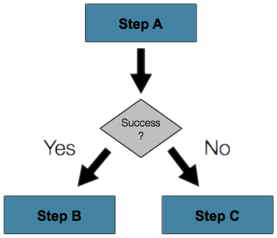

C#: Conditional Statements and Loops
Implementing Control-Flow Logic, Conditions and Loops in C#
Conditions
and Loops
SoftUni Team
Technical Trainers
Software University
http://softuni.bg

Slide 2

Table of Contents
Comparison Operators
Conditional Statements in C#
if and if-else Statements
The switch-case Statement
Logical Operators
Loops in C#
while and do ... while Loops
for Loops

Slide 3
Have a Question?
sli.do #extended-softuni

Slide 4

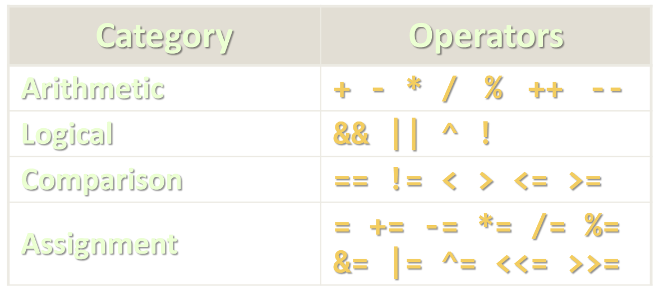
Comparison Operators

Slide 5
Comparing Numbers
Values can be compared in C# like in any other language:
var a = 5;
var b = 10;
Console.WriteLine(a < b); // True
Console.WriteLine(a > 0); // True
Console.WriteLine(a > 100); // False
Console.WriteLine(a < a); // False
Console.WriteLine(a <= 5); // True
Console.WriteLine(b == 2 * a); // True
Operator < (less than)
Operator > (greater than)
Operator <= (less or equal)
Operator == (equal)

Slide 6
Comparison Operators
Operator | Notation in C# | Applicable for
Equals | == | strings / numbers / dates / most objects
Not Equals | !=
Greater Than | > | numbers / dates / comparable objects
Greater Than or Equals | >=
Less Than | <
Less Than or Equals | <=
Example:
bool result = (5 <= 6);
Console.WriteLine(result); // True

Slide 7
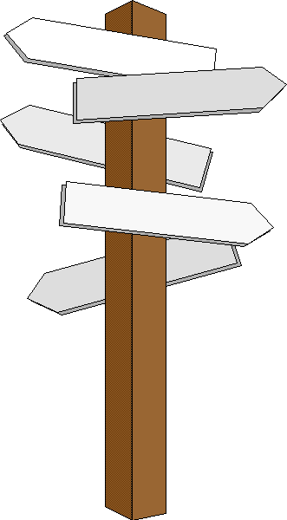
The if-else Statements
Implementing Control-Flow Logic

Slide 8
The if Statement
The most simple conditional statement
Test for a condition
Example: take as an input a grade and check if the student passed the exam (grade >= 3.00):
var grade = double.Parse(Console.ReadLine());
if (grade >= 3.00)
{
Console.WriteLine("Passed!");
}
In C# the opening bracket stays on a new line
Check your solution here: https://judge.softuni.bg/Contests/563

Slide 9
The if-else Statement
Executes one branch if the condition is true and another, if it is false
Example: Upgrade the last example, so it prints "Failed!", if the mark is lower than 3.00:
if (grade >= 3.00)
{
Console.WriteLine("Passed!");
}
else
{
// TODO: Print the message
}
The else keyword stays on a new line
Check your solution here: https://judge.softuni.bg/Contests/563

Slide 10
Problem: I Will be Back in 30 Minutes
Write a program that reads hours and minutes from the console and calculates the time after 30 minutes
The hours and the minutes come on separate lines
Example:
1
46
2:16
0
01
0:31
23
59
0:29
11
08
11:38
12
49
13:19
11
32
12:02
Check your solution here: https://judge.softuni.bg/Contests/563

Slide 11
Solution: I Will be Back in 30 Minutes
int hours = int.Parse(Console.ReadLine());
int minutes = int.Parse(Console.ReadLine()) + 30;
if (minutes > 59)
{
hours += 1;
minutes -= 60;
}
// Continue on the next slide
Check your solution here: https://judge.softuni.bg/Contests/563

Slide 12
Solution: I Will be Back in 30 Minutes (2)
if (hours > 23)
{
hours = 0;
}
if (minutes < 10)
{
Console.WriteLine("{0}:{1:D2}", hours, minutes);
}
else
{
Console.WriteLine("{0}:{1}", hours, minutes);
}
Check your solution here: https://judge.softuni.bg/Contests/563

Slide 13

The Switch-Case Statement
Simplified if-else-if-else

Slide 14
The switch-case Statement
Works as sequence of if-else statements
Example: read input a number and print its corresponding month:
var month = int.Parse(Console.ReadLine());
switch (month)
{
case 1: Console.WriteLine("January"); break;
case 2: Console.WriteLine("February"); break;
// TODO: Add the other cases
case 12: Console.WriteLine("December"); break;
default: Console.WriteLine("Error!"); break;
}
Check your solution here: https://judge.softuni.bg/Contests/563

Slide 15
Problem: Foreign Languages
By given country print its typical language: English -> England, USA; Spanish -> Spain, Argentina, Mexico; other -> unknown
switch (country)
{
case "USA":
case "England": Console.WriteLine("English"); break;
case "Spain":
case "Argentina":
case "Mexico": Console.WriteLine("Spanish"); break;
default: Console.WriteLine("unknown"); break;
}
Check your solution here: https://judge.softuni.bg/Contests/563

Slide 16
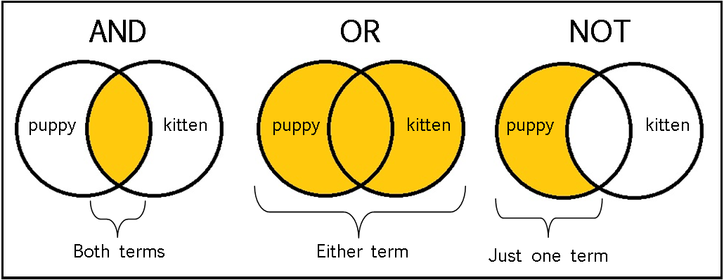
Logical Operators
Writing More Complex Conditions

Slide 17
Logical Operators
Operator | Notation in C# | Example
Logical NOT | ! | !false -> true
Logical AND | && | true && false -> false
Logical OR | || | true || false -> true
Logical operators give us the ability to write multiple conditions in one if statement
They return a boolean value and compare boolean values

Slide 18
Problem: Theatre Promotions
A theatre has the following ticket prices according to the age of the visitor and the type of day. If the age is < 0 or > 122, print "Error!":
Day / Age | 0 <= age <= 18 | 18 < age <= 64 | 64 < age <= 122
Weekday | 12$ | 18$ | 12$
Weekend | 15$ | 20$ | 15$
Holiday | 5$ | 12$ | 10$
Write a program to calculate the price for a single customer
Weekday
42
18$
Holiday
-12
Error!
Check your solution here: https://judge.softuni.bg/Contests/563

Slide 19
Solution: Theatre Promotion
var day = Console.ReadLine().ToLower();
var age = int.Parse(Console.ReadLine());
var price = 0;
if (day == "weekday")
{
if ((age >= 0 && age <= 18) || (age > 64 && age <= 122))
{
price = 12;
}
// TODO: Add else statement for the other group
}
// Continues on the next slide
Check your solution here: https://judge.softuni.bg/Contests/563

Slide 20
Solution: Theatre Promotion (2)
else if (day == "weekend")
{
if ((age >= 0 && age <= 18) || (age > 64 && age <= 122))
{
price = 15;
}
else if (age > 18 && age <= 64)
{
price = 20;
}
}
// Continue on the next slide
Check your solution here: https://judge.softuni.bg/Contests/563

Slide 21
Solution: Theatre Promotion (3)
else if (day == "holiday")
{
if (age >= 0 && age <= 18)
{
price = 5;
}
// TODO: Add the statements for the other cases
}
// Continue on the next slide
Check your solution here: https://judge.softuni.bg/Contests/563

Slide 22
Solution: Theatre Promotion (4)
if (price != 0)
{
Console.WriteLine(price + "$");
}
else
{
Console.WriteLine("Error!");
}
Check your solution here: https://judge.softuni.bg/Contests/563

Slide 23

Loops
Repeating a Piece of Code Multiple Times

Slide 24
Loop: Definition
A loop is a control statement that repeats the execution of a block of statements. The loop can:
Execute a code block a fixed number of times
for loop
Execute a code block while a given condition returns true
while
do…while
In C# we have all of the above types of loops

Slide 25

For-Loops
for-loops
Managing the Count of the Iteration

Slide 26
For-Loops
The for loop executes statements a fixed number of times:
Initial value
End value
Increment
for (var i = 1; i <= 10; i++)
{
Console.WriteLine("i = " + i);
}
Loop body
Executed at each iteration
The bracket is again at the new line

Slide 27

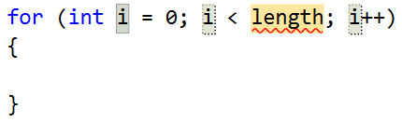
Example: Divisible by 3
Print the numbers from 1 to 100, that are divisible by 3
You can use "for-loop" code snippet in Visual Studio
for (var i = 3; i <= 100; i += 3)
{
Console.WriteLine(i);
}
Push [Tab] twice
Check your solution here: https://judge.softuni.bg/Contests/563

Slide 28
Problem: Sum of Odd Numbers
Write a program to print the first n odd numbers and their sum
1
3
5
7
9
Sum: 25
1
3
5
Sum: 9
5
3
Check your solution here: https://judge.softuni.bg/Contests/563

Slide 29
Solution: Sum of Odd Numbers
var n = int.Parse(Console.ReadLine());
var sum = 0;
for (var i = 1; i <= n; i++)
{
Console.WriteLine("{0}", 2 * i - 1);
sum += 2 * i - 1;
}
Console.WriteLine($"Sum:{sum}");
Check your solution here: https://judge.softuni.bg/Contests/563

Slide 30
While-Loops
false
condition
true
commands
Iterations While a Condition is True

Slide 31
While Loops
Executes commands while the condition is true:
Initial value
Condition
var n = 1;
while (n <= 10)
{
Console.WriteLine(n);
n++;
}
Loop body
Increment the counter

Slide 32
Problem: Multiplication Table
Print a table holding number*1, number*2, …, number*10
var number = int.Parse(Console.ReadLine());
var times = 1;
while (times <= 10)
{
Console.WriteLine(
$"{number} X {times} = {number * times}");
times++;
}
3
3 X 1 = 3
3 X 2 = 6
3 X 3 = 9
3 X 4 = 12
3 X 5 = 15
3 X 6 = 18
3 X 7 = 21
3 X 8 = 24
3 X 9 = 27
3 X 10 = 30
Check your solution here: https://judge.softuni.bg/Contests/563

Slide 33
Do…While Loop
commands
true
false
condition
Execute a Piece of Code One or More Times

Slide 34
Do ... While Loop
Similar to the while loop, but always executes at least once:
Initial value
var i = 1;
do
{
Console.WriteLine(i);
i++;
}
while (i <= 10);
Loop body
Increment the counter
Condition

Slide 35
Problem: Multiplication Table 2.0
Upgrade your program and take the initial times from the console
Print result at least for the first calculation
var number = int.Parse(Console.ReadLine());
var times = int.Parse(Console.ReadLine());
do
{
Console.WriteLine(
$"{number} X {times} = {number * times}");
times++;
} while (times <= 10);
Check your solution here: https://judge.softuni.bg/Contests/563

Slide 36
Problem: Odd Number. The break Keyword
The break keyword exits the innermost loop
Take as an input an odd number and print its absolute value
If the number is even, print "Please write an odd number."
var num = Math.Abs(int.Parse(Console.ReadLine()));
while (true)
{
if (num % 2 == 1)
break;
// TODO: Print an error message and read another number
}
Console.WriteLine("The number is: {0}", num);
break exits the loop
Check your solution here: https://judge.softuni.bg/Contests/563

Slide 37
Handling Errors with Try-Catch
In C# we can catch errors and handle them using custom logic
Write a program to read input from the console and prints its type
Print "It is a number.", if it’s a number
Print "Invalid input!" otherwise
5
It is a number.
five
Invalid input!
Check your solution here: https://judge.softuni.bg/Contests/563

Slide 38
Solution: Number Checker
try
{
var n = int.Parse(Console.ReadLine());
Console.WriteLine("It is a number.");
}
catch (NumberFormatException)
{
Console.WriteLine("Invalid input!");
}
Exception type
Check your solution here: https://judge.softuni.bg/Contests/563

Slide 39
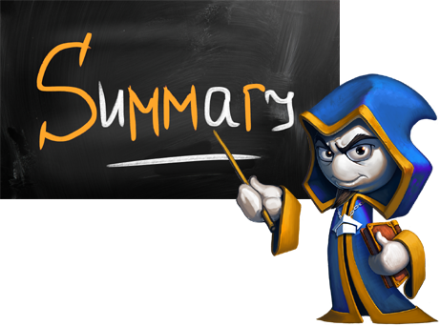
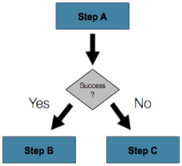
Summary
If-statements in C# are like in Java, JS, C++, …
Loops in C# are like in Java, JS, C++, …
The bracket in C# is stays at the new line
The break keyword exits the innermost loop
Exceptions are runtime errors
The try-catch statement catches exceptions and executes custom logic

Slide 40








C#: Conditional Statements and Loops
https://softuni.bg/courses/

Slide 41
License
This course (slides, examples, demos, videos, homework, etc.) is licensed under the "Creative Commons Attribution-NonCommercial-ShareAlike 4.0 International" license

Slide 42




Trainings @ Software University (SoftUni)
Software University – High-Quality Education, Profession and Job for Software Developers
softuni.bg
Software University Foundation
softuni.org
Software University @ Facebook
facebook.com/SoftwareUniversity
Software University Forums
forum.softuni.bg

